Slide 1
TWITTER DATA
CASE II – POLITICAL DISCOURSE OR NOT ?

Slide 2

AGENDA
Introduction
Insights , Top Words and Frequency
Document Classification
Conclusion

Slide 3
INSIGHTS
Data Set contains 2000 records
Frequent Words and Averages
Out of 2000 – 572 entries were political tweets
1 = Political 0 = Non-Political

Slide 4


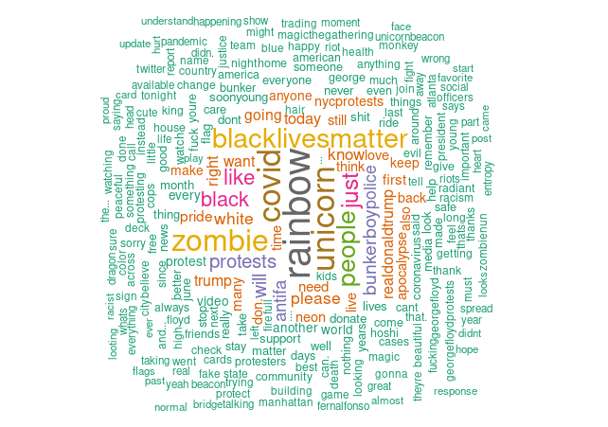
TOP WORDS
Top Words – black lives matter, bunker boy police, protests, realdonaldtrump, black, antifa

Slide 5
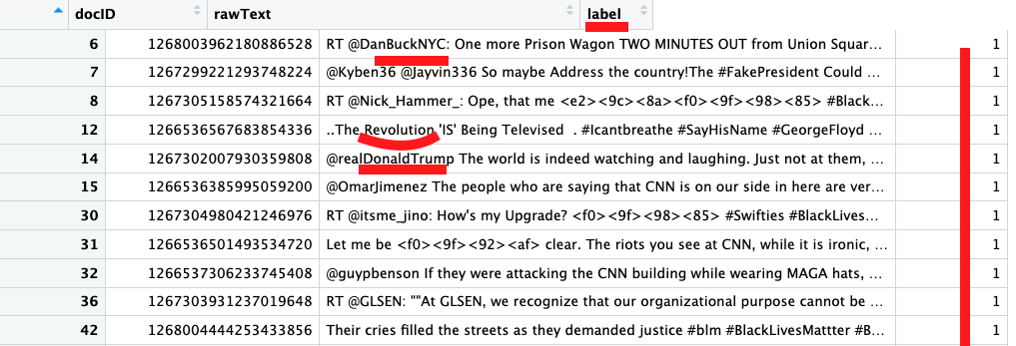
INSIGHTS
Showing the labelling of 1 = Political Discourse Statements made by users
The mean or average of political discourse statements made by twitter users is around 27% whereas 71.4% of the twitter posts are about other things

Slide 6
Documents Classification- Preprocessing Steps
Build model on Training data
Evaluating on the Validation data
Re-evaluate on the Testing data
Prediction and Classification on the New Data

Slide 7
DOCUMENT CLASSIFICATION
Loading the Training and Validation data
Partition Data 80% - train 20% - validation
Cleaning and Creating stop words and removing them using a function
Original count of vocab 9k after cleaning it came down to 213
Using CV GLMNET for modelling
Running Predication using Document Term Matrix
Running prediction on Training and Validation Data using a confusion matrix
Notes:
cv.glmnet() performs cross-validation, by default 10-fold which can be adjusted using nfolds. A 10-fold CV will randomly divide your observations into 10 non-overlapping groups/folds of approx equal size.
The first fold will be used for validation set and the model is fit on 9 folds. Bias Variance advantages is usually the motivation behind using such model validation methods. In the case of lasso and ridge models, CV helps choose the value of the tuning parameter lambda.

Slide 8
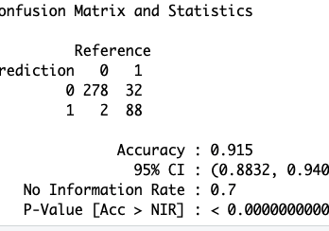
DOCUMENT CLASSIFICATION – ACCURACY VALIDATION SET
ACCURACY OF THE VALIDATION SET – 95%

Slide 9
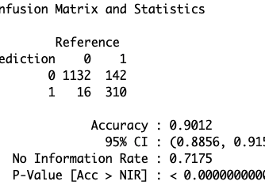
DOCUMENT CLASSIFICATION – ACCURACY TEST SET
ACCURACY OF THE TEST SET – 90%

Slide 10
CONCLUSION
Based on the information provided in these slides we see that we have predicted a 95% chance of civil unrest in the validation set of data and 90% chance in the test set

